Slide 1
Variational Auto-Encoders (Part 2)

Slide 2
What we’ll learn about Variational Auto-Encoders:
Part 1 (previous): The “simple” explanation of a VAE, as a regularized AE
What is a VAE
How to train VAEs
How do different terms of training loss influence what VAE learns
How does a VAE relate to the basic AE
Part 2 (this video): Applications of VAE for…
Generation of new data points
Modifying data via interpolating between 2 inputs
Modifying specific feature of an input
Compression => Reconstruction
Part 3: The probabilistic derivation of a VAE (Optional, non-assessed. To be published at a later date)
Derivation of VAE as a probabilistic model for Density Estimation

Slide 3
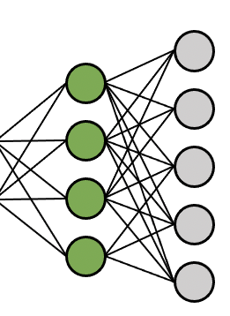
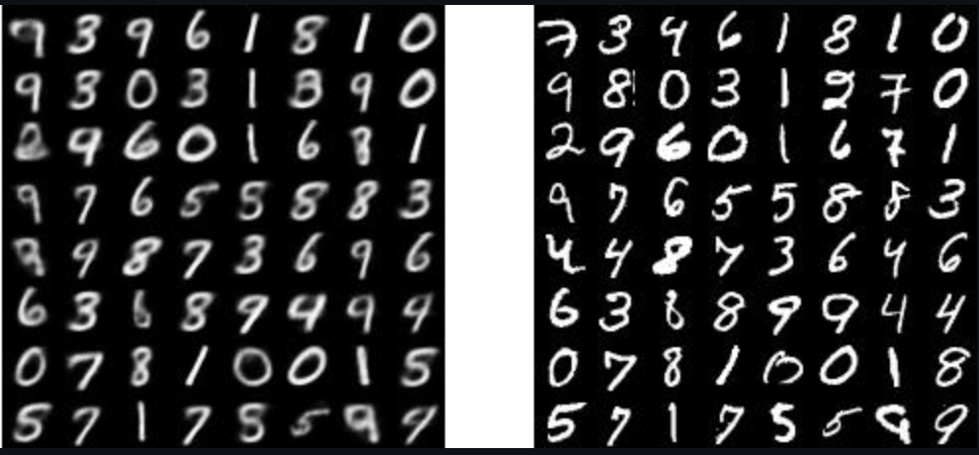
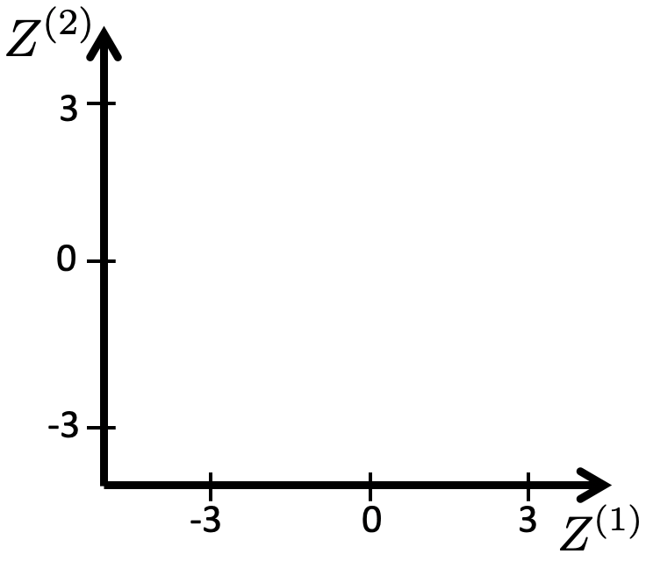
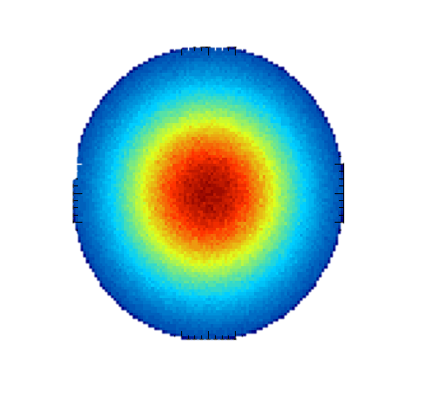

VAE: Training
Predicted “conditional” or “posterior” of z given x
sample
“prior” distribution of z,

Slide 4
VAE: Generating new data by sampling from prior
“prior” distribution of z,
sample

Slide 5
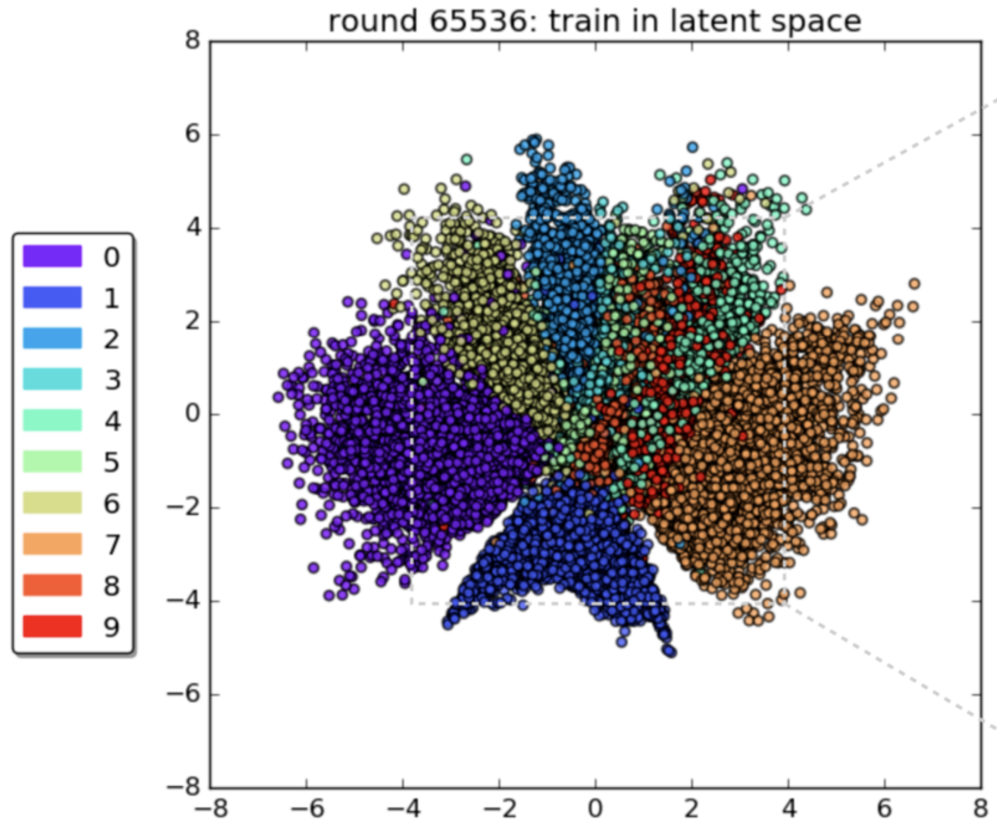
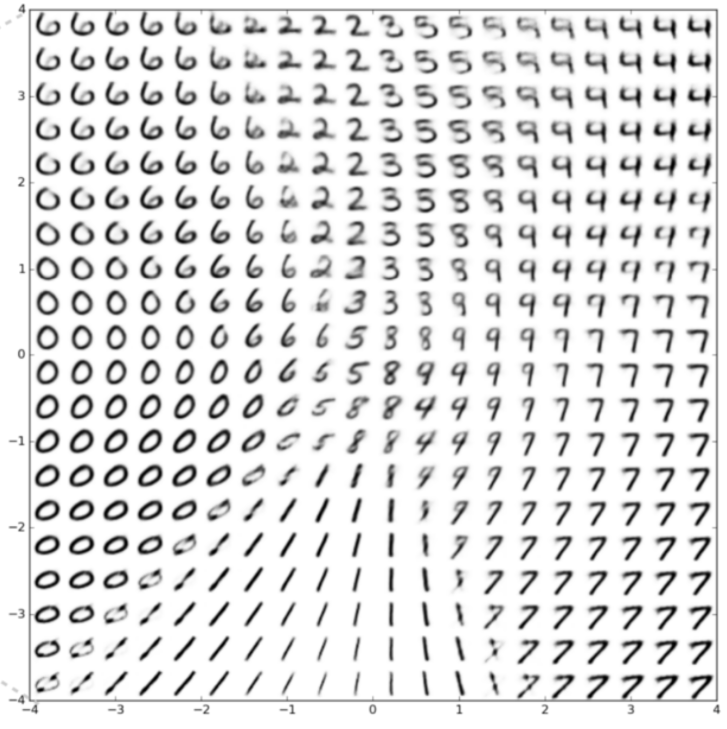
Generating (synthesizing) new data with VAE
3
Each dot is the mean code of a training sample,
0
-3
-3
0
3
Values of z were sampled on a grid, under the area (-3,+3) covered by the prior.
Images from: Cloudera Fast Forward (link)

Slide 6
Generating (synthesizing) new data with VAE
3
Each dot is the mean code of a training sample,
0
-3
-3
0
3
Even for VAE, some “gaps” can still be left in space of Z. Why?
Reconstruction loss encourages separation of dissimilar data, “opposing” the regularizer.
SGD optimization does not find global optimum.
Values of z were sampled on a grid, under the area (-3,+3) covered by the prior.
Images from: Cloudera Fast Forward (link)

Slide 7
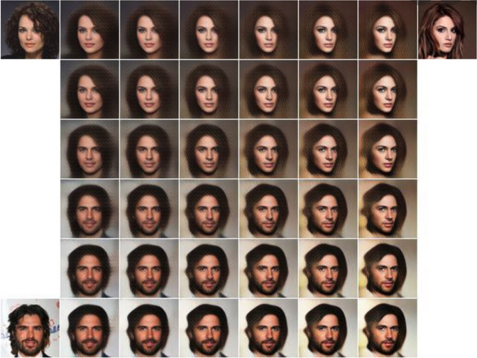
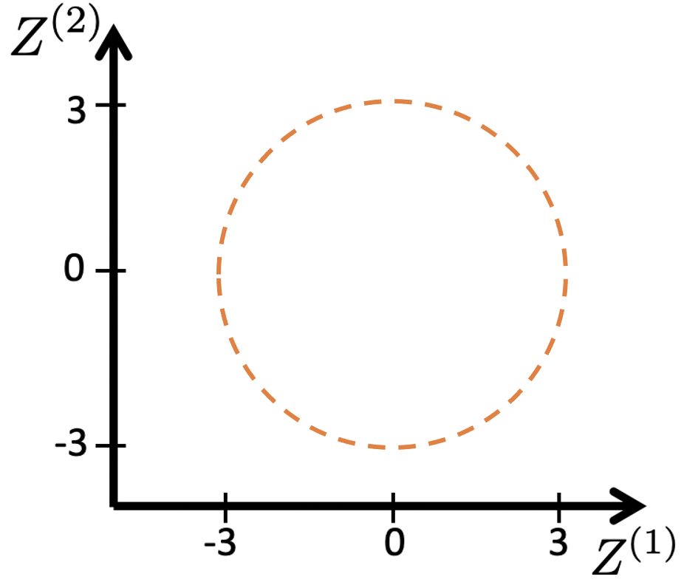
Interpolating between different inputs with VAE
Algorithm:
Encode inputs x and get as z. E.g.
Create new z code by interpolation E.g.
Decode z with decoder.
Can be for 2 or more inputs.
Image from: Fathy Rashad (link)

Slide 8
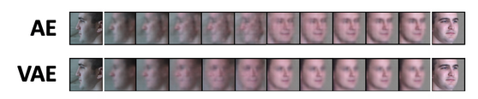
Interpolating between inputs: basic AE vs VAE
Problematic results, and a sudden (non-smooth) change
VAE tends to gives smoother interpolation
Image from: Yan et al, "Semantics-Guided Representation Learning with Applications to Visual Synthesis”, 2020

Slide 9
Interpolation with a VAE gives “smoothly” changing output
Image from: Fathy Rashad (link)

Slide 10
Interpolation with a VAE gives “smoothly” changing output
Image from: Fathy Rashad (link)
Smoothness: No sudden changes between 2 nearby z values. Thanks to training with Gaussian distribution p_{φ}(y|z) for encoding. In VAE, values of z between 2 training datapoints are associated with probability p_{φ}(z|x₁) code of one training image x₁, and probability p(z|x₂) code of another training image x₂, where the 2 Gaussians predicted by encoder overlap. Therefore, decoding such intermediate values z leads to an image that has characteristics of both images that their p(z|x) overlap at that value of z. As we move in space of Z, Gaussians p(z|x) vary smoothly, and so characteristics in decoded images will vary smoothly.

Slide 11

Altering specific features of data with VAE

Slide 12
Altering specific features of data with VAE
of data with target feature

Slide 13
Altering specific features of data with VAE
, average of mean codes of data with target feature
of data with target feature
Increasing
Image from: Steven Flores (link)

Slide 14
Altering specific features of data with VAE
Algorithm:
Encode original input x and use predicted as its code: E.g.
Identify all training samples that have the desired “target” characteristic. E.g. blondes. Assume these are
Encode all training samples with the target characteristic. Use mean of the Gaussian predicted by encoder as the code. E.g.
Compute average value of codes of all samples with target characteristic:
Create new z code by interpolation E.g.
Decode z with decoder.
Possible with more than 1 target features, similarly to algo on Slide 7.
, average of mean codes of data with target feature
of data with target feature
Increasing
Requirement: *Need* to know which data have the target characteristic (e.g. blonde hair)
Image from: Steven Flores (link)

Slide 15
Altering specific features of data with basic Auto-Encoder
The same procedure can be done via a basic (deterministic) Auto-Encoder.
What issues do you expect and why?

Slide 16
Using VAEs for Compression and Reconstruction
After a VAE is trained, we may consider using it for compression and reconstruction.
Q: If we want the best possible reconstruction of x, which code z should we give as input to the decoder?
?
A: The predicted mean by the encoder. This is the value of z that is most likely to be the correct encoding of x according to encoder.

Slide 17
Using VAEs for Compression and Reconstruction
After a VAE is trained, we may consider using it for compression and reconstruction.
To get the best possible reconstruction from a VAE, we simply decode . We do not use the predicted standard deviation, nor sample.

Slide 18
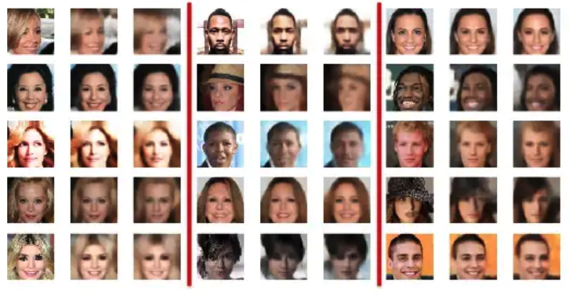
Reconstruction with VAE vs basic AE
VAE’s capacity is used to optimize both reconstruction and regularization losses.
These two losses have competing goals!
Therefore its reconstructions may not be as good as those from a basic AE of similar capacity.
It is not what VAE is made for!
Real
AE
VAE
Real
AE
VAE
Real
AE
VAE
From: Steven Flores, Variational Autoencoders for Image Generation

Slide 19
In this video:
What we can use VAEs for:
Generation of new data points
Modifying data via interpolating between 2 inputs
Modifying specific feature of an input
What VAE is not ideal for:
Compression => Reconstruction
Next weeks:
Generative Adversarial Networks
Probabilistic derivation of VAEs (non-assessed, optional, if time allows)

Slide 20
Thank you very much

